Slide 1
Computer Architecture
Vivek Shrivastava
IIPS, DAVV

Slide 2
Architecture & Organization 1
Architecture is those attributes or components visible to the programmer or those attributes that have direct impact on the logical execution of a program.Answers:How a computer is designed?
Instruction set, number of bits used for data representation, I/O mechanisms, addressing techniques.
e.g. Is there a multiply instruction?
Organization is how features are implemented
Control signals, interfaces, memory technology.
e.g. Is there a hardware multiply unit or is it done by repeated addition?

Slide 3
Architecture & Organization 2
All Intel x86 family share the same basic architecture
The IBM System/370 family share the same basic architecture
In the case of the IBM, SUN and Intel ISAs, it is possible to purchase processors which execute the same instructions from more than one manufacturer
All these processors may have quite different internal organizations but they all appear identical to a programmer, because their instruction sets are the same
This gives code compatibility
At least backwards
Organization differs between different versions

Slide 4
ENIAC - background
Electronic Numerical Integrator And Computer
Eckert and Mauchly
University of Pennsylvania
Trajectory tables for weapons
Started 1943
Finished 1946
Too late for war effort
Used until 1955

Slide 5
ENIAC - details
Decimal (not binary)
20 accumulators of 10 digits
Programmed manually by switches
18,000 vacuum tubes
30 tons
15,000 square feet
140 kW power consumption
5,000 additions per second

Slide 6
von Neumann/Turing
Stored Program concept
Main memory storing programs and data
ALU operating on binary data
Control unit interpreting instructions from memory and executing
Input and output equipment operated by control unit
Princeton Institute for Advanced Studies
IAS
Completed 1952

Slide 7
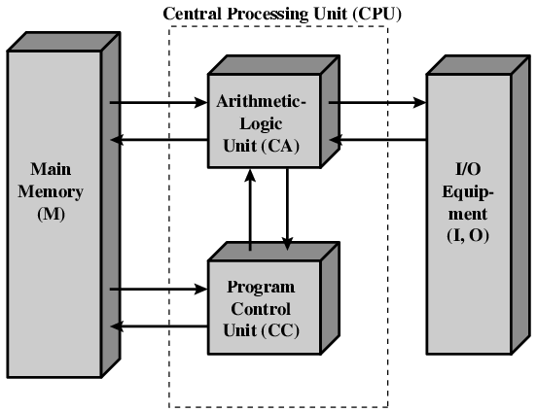
Structure of von Neumann machine

Slide 8
IAS - details
1000 x 40 bit words
Binary number
2 x 20 bit instructions
Set of registers (storage in CPU)
Memory Buffer Register
Memory Address Register
Instruction Register
Instruction Buffer Register
Program Counter
Accumulator
Multiplier Quotient

Slide 9
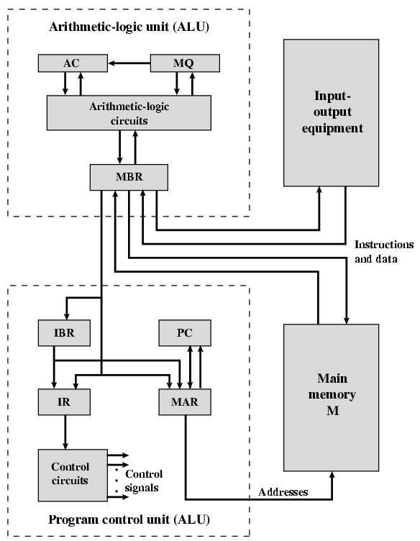
Structure of IAS – detail

Slide 10
Commercial Computers
1947 - Eckert-Mauchly Computer Corporation
UNIVAC I (Universal Automatic Computer)
US Bureau of Census 1950 calculations
Became part of Sperry-Rand Corporation
Late 1950s - UNIVAC II
Faster
More memory

Slide 11
IBM
Punched-card processing equipment
1953 - the 701
IBM’s first stored program computer
Scientific calculations
1955 - the 702
Business applications
Lead to 700/7000 series

Slide 12
Transistors
Replaced vacuum tubes
Smaller
Cheaper
Less heat dissipation
Solid State device
Made from Silicon (Sand)
Invented 1947 at Bell Labs
William Shockley et al.

Slide 13
Transistor Based Computers
Second generation machines
NCR & RCA produced small transistor machines
IBM 7000
DEC - 1957
Produced PDP-1

Slide 14
Microelectronics
Literally - “small electronics”
A computer is made up of gates, memory cells and interconnections
These can be manufactured on a semiconductor
e.g. silicon wafer

Slide 15
Generations of Computer
Vacuum tube - 1946-1957
Transistor - 1958-1964
Small scale integration - 1965 on
Up to 100 devices on a chip
Medium scale integration - to 1971
100-3,000 devices on a chip
Large scale integration - 1971-1977
3,000 - 100,000 devices on a chip
Very large scale integration - 1978 -1991
100,000 - 100,000,000 devices on a chip
Ultra large scale integration – 1991 -
Over 100,000,000 devices on a chip

Slide 16
Internet Resources
http://www.intel.com/
Search for the Intel Museum
http://www.ibm.com
http://www.dec.com
Charles Babbage Institute
PowerPC
Intel Developer Home

Slide 17
References
William Stallings , Computer Organization and Architecture 8th Edition.
AMDA67 Amdahl, G. “Validity of the Single-Processor Approach to Achieving Large-Scale Computing Capability”, Proceedings of the AFIPS Conference, 1967.

